Slide 1




University Institute of Engineering
Department of Computer Science & Engineering
COMPUTER ORGANIZATION & ARCHITECTURE
(23CST-204/23ITT-204)
ER. SHIKHA ATWAL
E11186
ASSISTANT PROFESSOR
BE-CSE

Slide 2

PIPELINING
Instruction is the smallest execution packet of a program.
Each instruction contains one or more operations.
Simple scalar processors execute one or more instruction per clock cycle, with each instruction containing only one operation.
Instructions are executed in a sequence of phases to produce the expected results. This sequence is given below:

Slide 3
IF: Fetches the instruction into the instruction register.
ID: Instruction Decode, decodes the instruction for the opcode.
AG: Address Generator, generates the address.
DF: Data Fetch, fetches the operands into the data register.
EX: Execution executes the specified operation.
WB: Write back, writes back the result to the register.
In pipelining, these different phases are performed concurrently.
These phases are considered independent between different operations and can be overlapped.
Thus, multiple operations can be performed simultaneously, with each operation having its own independent phase.

Slide 4
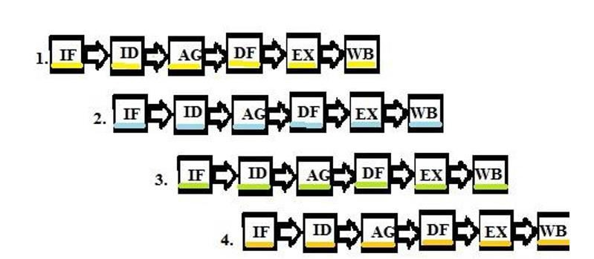
Instruction Pipelining
Let us look at the way instructions are processed in pipelining.

Slide 5
In a simple pipelining processor, at any given time, there is only one operation in each phase.
In initial IF phase, one operation is fetched on the first clock cycle.
When the next clock pulse arrives, the first operation goes into the ID phase, leaving the IF phase empty.
Now, this empty phase is allocated to the next operation. So, during the second clock pulse, the first operation is in the ID phase, and the second operation is in the IF phase.

Slide 6
For the third cycle, the first operation will be in the AG phase, the second operation will be in the ID phase, and the third operation will be in the IF phase.
In this way, instructions are executed concurrently, and after six cycles, the processor will output a completely executed instruction per clock cycle.
For execution of each instruction, the processor would require six clock cycles.
But in a pipelined processor, as the execution of instructions takes place concurrently, only the initial instruction requires six cycles, and all the remaining instructions are executed as one per cycle, thereby reducing the time of execution and increasing the speed of the processor.

Slide 7
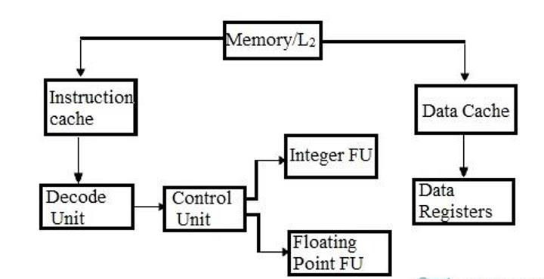
Pipelining Architecture
Parallelism can be achieved with hardware, compilers, and software techniques.
Many processor units are interconnected and are functioned concurrently. In the pipelined processor architecture, there are separate processing units provided for integers and floating-point instructions.
Pipelined Processor Unit

Slide 8
In static pipelining, the processor should pass the instruction through all phases of the pipeline, regardless of the requirement of the instruction.
In dynamic pipeline processor, an instruction can bypass the phases depending on its requirement but has to move in sequential order.
In complex dynamic pipeline processor, the instruction can bypass the phases as well as choose the phases out of order.
Classification of pipeline processor
Pipeline processors are classified as:
Arithmetic pipeline
Instruction pipeline
Processor pipeline

Slide 9
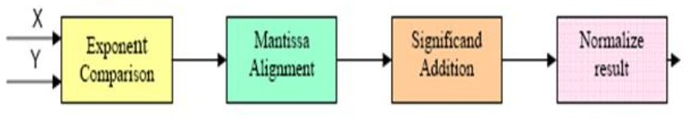
Arithmetic pipeline
An arithmetic pipeline generally breaks an arithmetic operation into multiple arithmetic steps.
So, in an arithmetic pipeline, an arithmetic operation like multiplication, addition, etc. can be divided into a series of steps that can be executed one by one in stages in an Arithmetic Logic Unit (ALU).

Slide 10

Instruction pipeline
In an instruction pipeline processor, the execution of a stream of instructions can be pipelined by overlapping the execution of the current instruction with the fetch, decode, and operand fetch of subsequent instructions.
Example of an Instruction Pipeline
All high-performance computers nowadays are equipped with an instruction-pipeline processor.

Slide 11
Processor pipeline
In a processor pipeline, processing of the same data stream is done by a cascade of processors. In this, each cascade of processors is assigned and processes a specific task.
There is no practical example found for processor pipelines.

Slide 12
PIPELINE HAZARDS IN COMPUTER ARCHITECTURE
Pipeline hazards are encountered in some specific situations that prevent the next instruction in the instruction stream from being fetched during its designated clock cycle.
The instruction that is prevented from being fetched is said to be stalled.
Instructions that have already been executed before the stall occurred can continue.
During the stall, however, new instructions are not fetched. Depending on the situation that causes a stall state, there are different types of pipeline hazards.

Slide 13
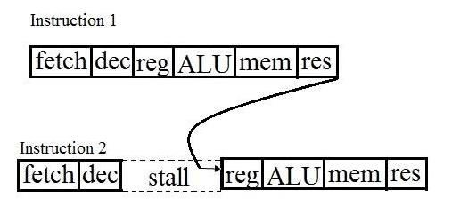
The result of one instruction is used as an operand for another instruction.
When such instructions are executed in pipelining, break down occurs as the result of the first instruction is not available when instruction two starts collecting operands.
So, instruction two must stall until instruction one is executed and the result is generated. This type of hazard is called the read-after-write pipelining hazard.
Read After Write Pipelining Hazard

Slide 14
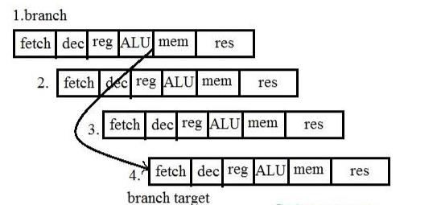
Execution of branch instructions also causes a pipelining hazard. Branch instructions in pipelines have an effect on the fetch stages of the next instructions.
Pipelined Branch Behaviour

Slide 15
Pipeline hazards are classified as follows:
Structural hazards
Data hazards
Control hazards
Dependencies can be addressed in a variety of ways. The easiest is to introduce a bubble into the pipeline, which stalls it and limits throughput. The bubble forces the next instruction to wait until the previous one is completed.

Slide 16
Structural Hazards:
Hardware resource conflicts among the instructions in the pipeline cause structural hazards.
When more than one instruction in the pipe requires access to the very same resource in the same clock cycle, a resource conflict is said to arise.
In an overlapping pipelined execution, this is a circumstance where the hardware cannot handle all potential combinations.

Slide 17
Data Hazards:
Data hazards in pipelining emerge when the execution of one instruction is dependent on the results of another instruction that is still being processed in the pipeline.
The order of the READ or WRITE operations on the register is used to classify data threats into three groups.

Slide 18
Control Hazards:
Branch hazards are caused by branch instructions and are known as control hazards.
The flow of program/instruction execution is controlled by branch instructions. As a result, when the decision to execute one instruction is reliant on the result of another instruction, such as a conditional branch, which examines the condition’s consequent value, a conditional hazard develops.

Slide 19
PIPELINE CONFLICTS
There are some factors that cause the pipeline to deviate its normal performance.
Timing Variations: All stages cannot take the same amount of time. This problem generally occurs in instruction processing, where different instructions have different operand requirements and thus different processing time.
Data Hazards: When several instructions are in partial execution and they reference the same data, a problem arises. We must ensure that the next instruction does not attempt to access data before the current instruction, because this will lead to incorrect results.

Slide 20
3. Branching: In order to fetch and execute the next instruction, we must know what that instruction is. If the present instruction is a conditional branch, and its result will lead us to the next instruction, then the next instruction may not be known until the current one is processed.
4. Interrupts: Interrupts set unwanted instructions into the instruction stream. Interrupts affect the execution of instructions.
5. Data Dependency: It arises when an instruction depends on the result of a previous instruction, but this result is not yet available.

Slide 21
Advantages of Pipelining
Instruction throughput increases.
An increase in the number of pipeline stages increases the number of instructions executed simultaneously.
Faster ALU can be designed when pipelining is used.
Pipelined CPUs work at higher clock frequencies than the RAM.
Pipelining increases the overall performance of the CPU.

Slide 22
Disadvantages of Pipelining
The design of the pipelined processor is complex.
In pipelined processors, instruction latency increases.
The throughput of a pipelined processor is difficult to predict.
The longer the pipeline, the worse the problem of hazard for branch instructions.

Slide 23
References
Reference Books:
J.P. Hayes, “Computer Architecture and Organization”, Third Edition.
Mano, M., “Computer System Architecture”, Third Edition, Prentice Hall.
Stallings, W., “Computer Organization and Architecture”, Eighth Edition, Pearson Education.
Text Books:
Carpinelli J.D,” Computer systems organization &Architecture”, Fourth Edition, Addison Wesley.
Patterson and Hennessy, “Computer Architecture”, Fifth Edition Morgaon Kauffman.

Slide 24
Other References:
https://www.studytonight.com/computer-architecture/pipelining
https://www.tutorialspoint.com/what-is-pipelining
https://www.elprocus.com/pipelining-architecture-hazards-advantages-disadvantages/
https://byjus.com/gate/pipeline-hazards-in-computer-architecture-notes/
Video Links:
https://youtu.be/nv0yAm5gc-E?si=czkhPg50tPVMBUYN
https://youtu.be/Rql_NCoYqsM?si=9FHzU0YyDYERd1eX
https://youtu.be/z4ycnUz5tNE?si=nmumR_QokgM4tK2n
https://youtu.be/srlgaJgaxRE?si=BYzDL8JvgrrnAlIW
https://youtu.be/qn7zf_OSLsk?si=2j0_nBEMjvjEixK2
https://youtu.be/h0IentwmZLU?si=8uDp8Y1p9po4o1yn

